Slide 1
Camp Quality
Felicity the medication management app

Slide 2
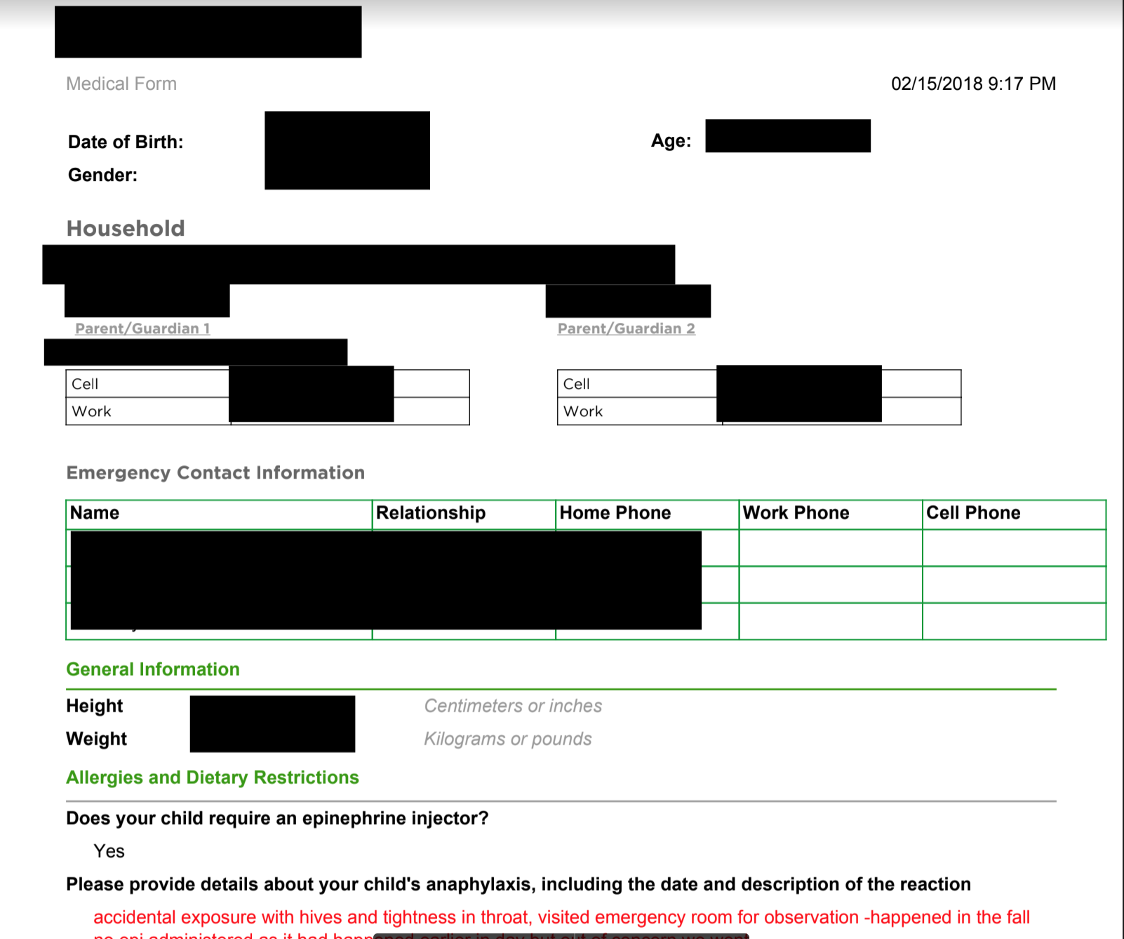
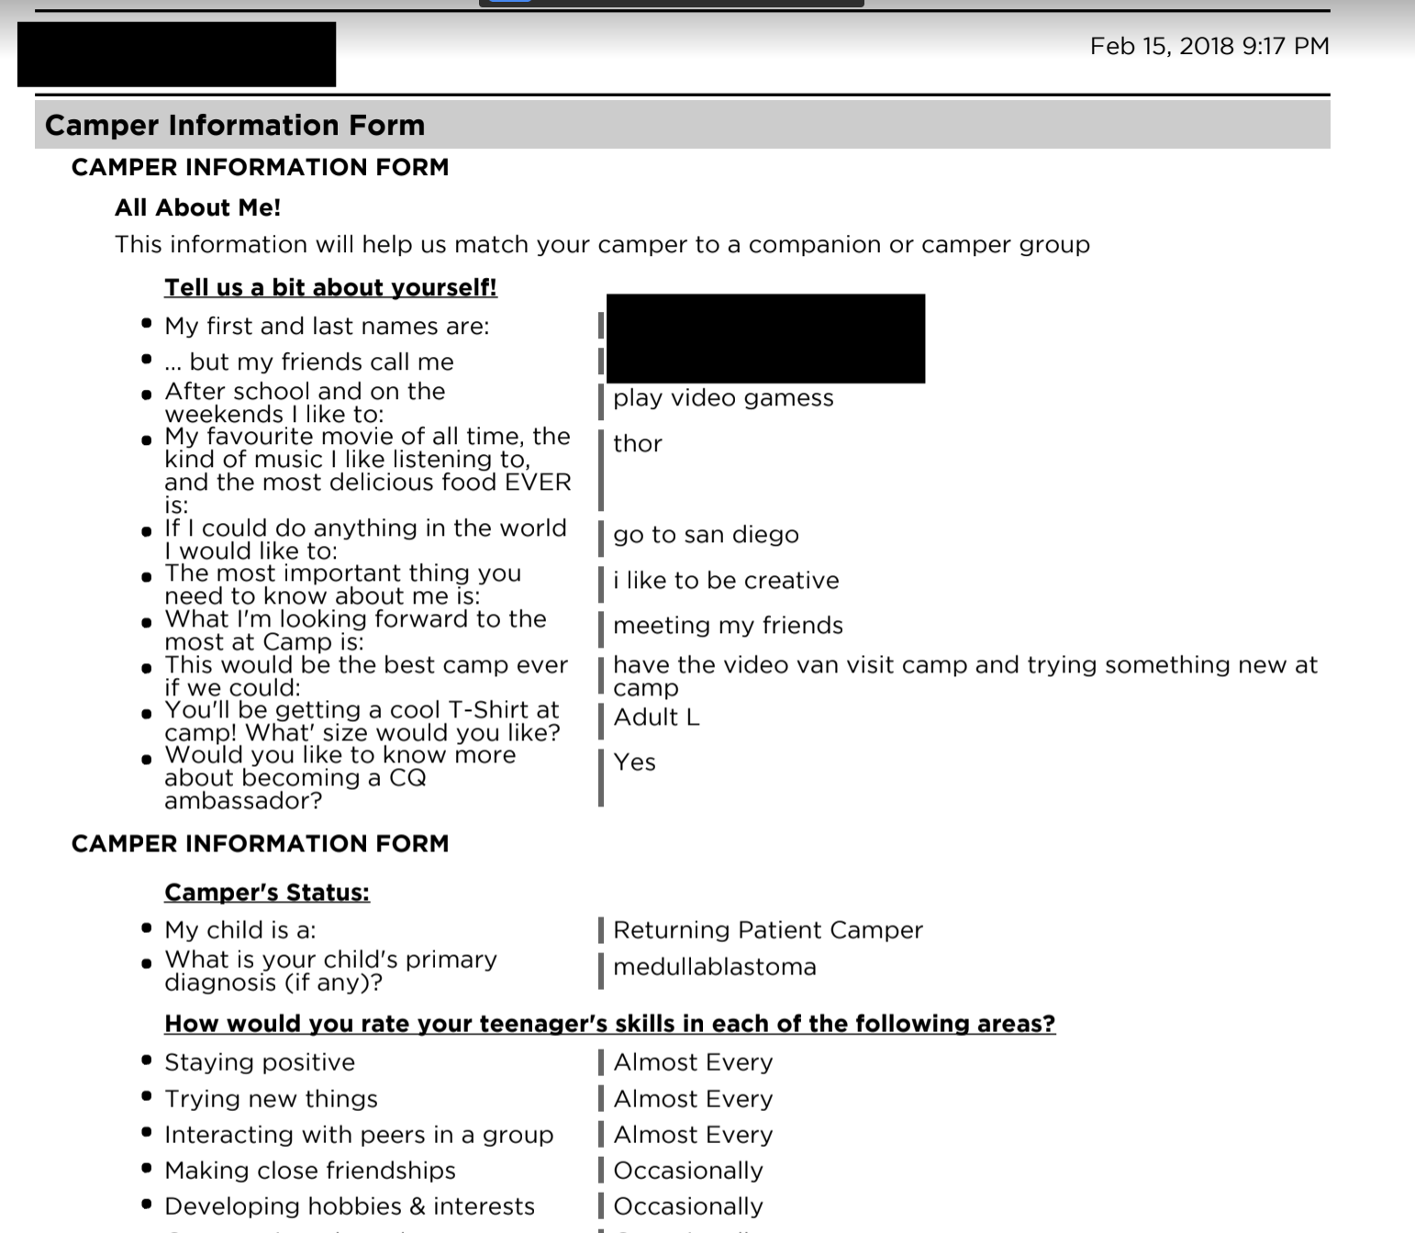
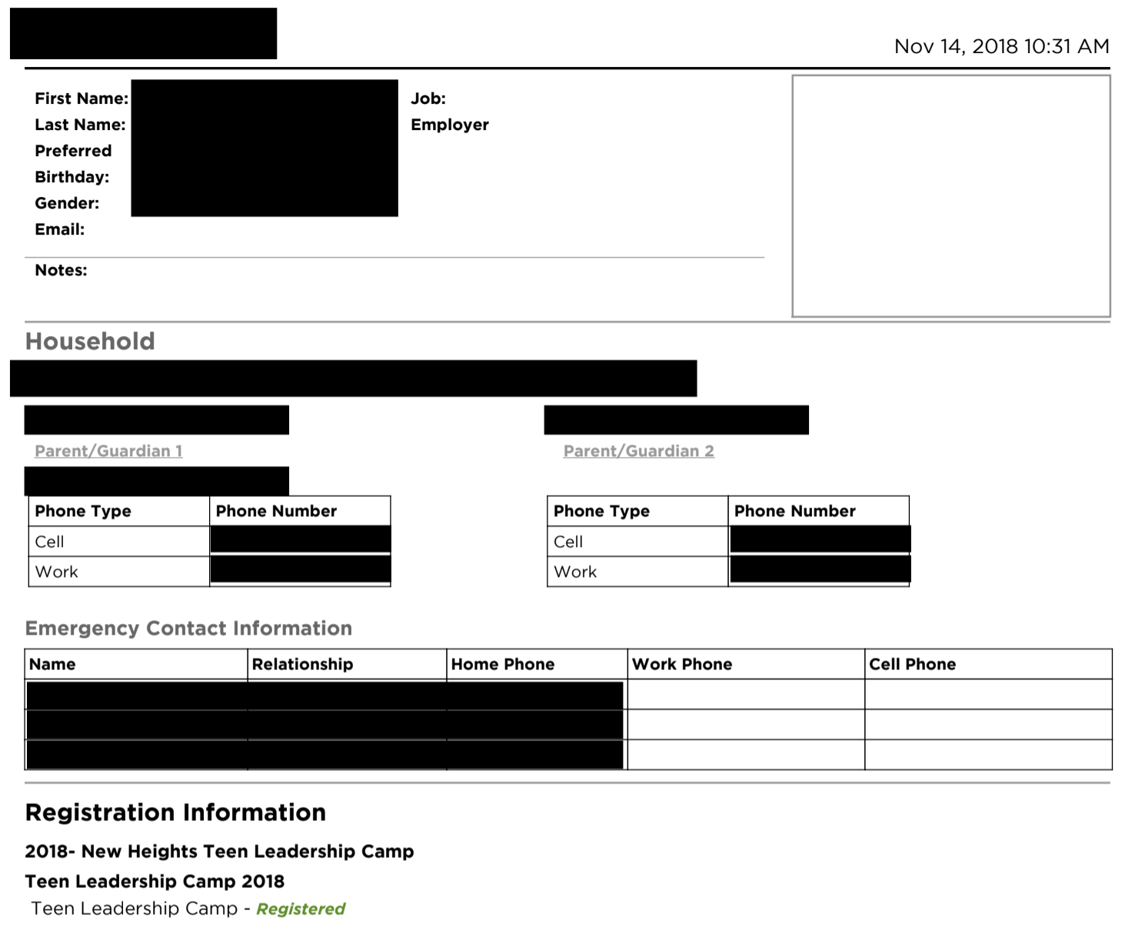
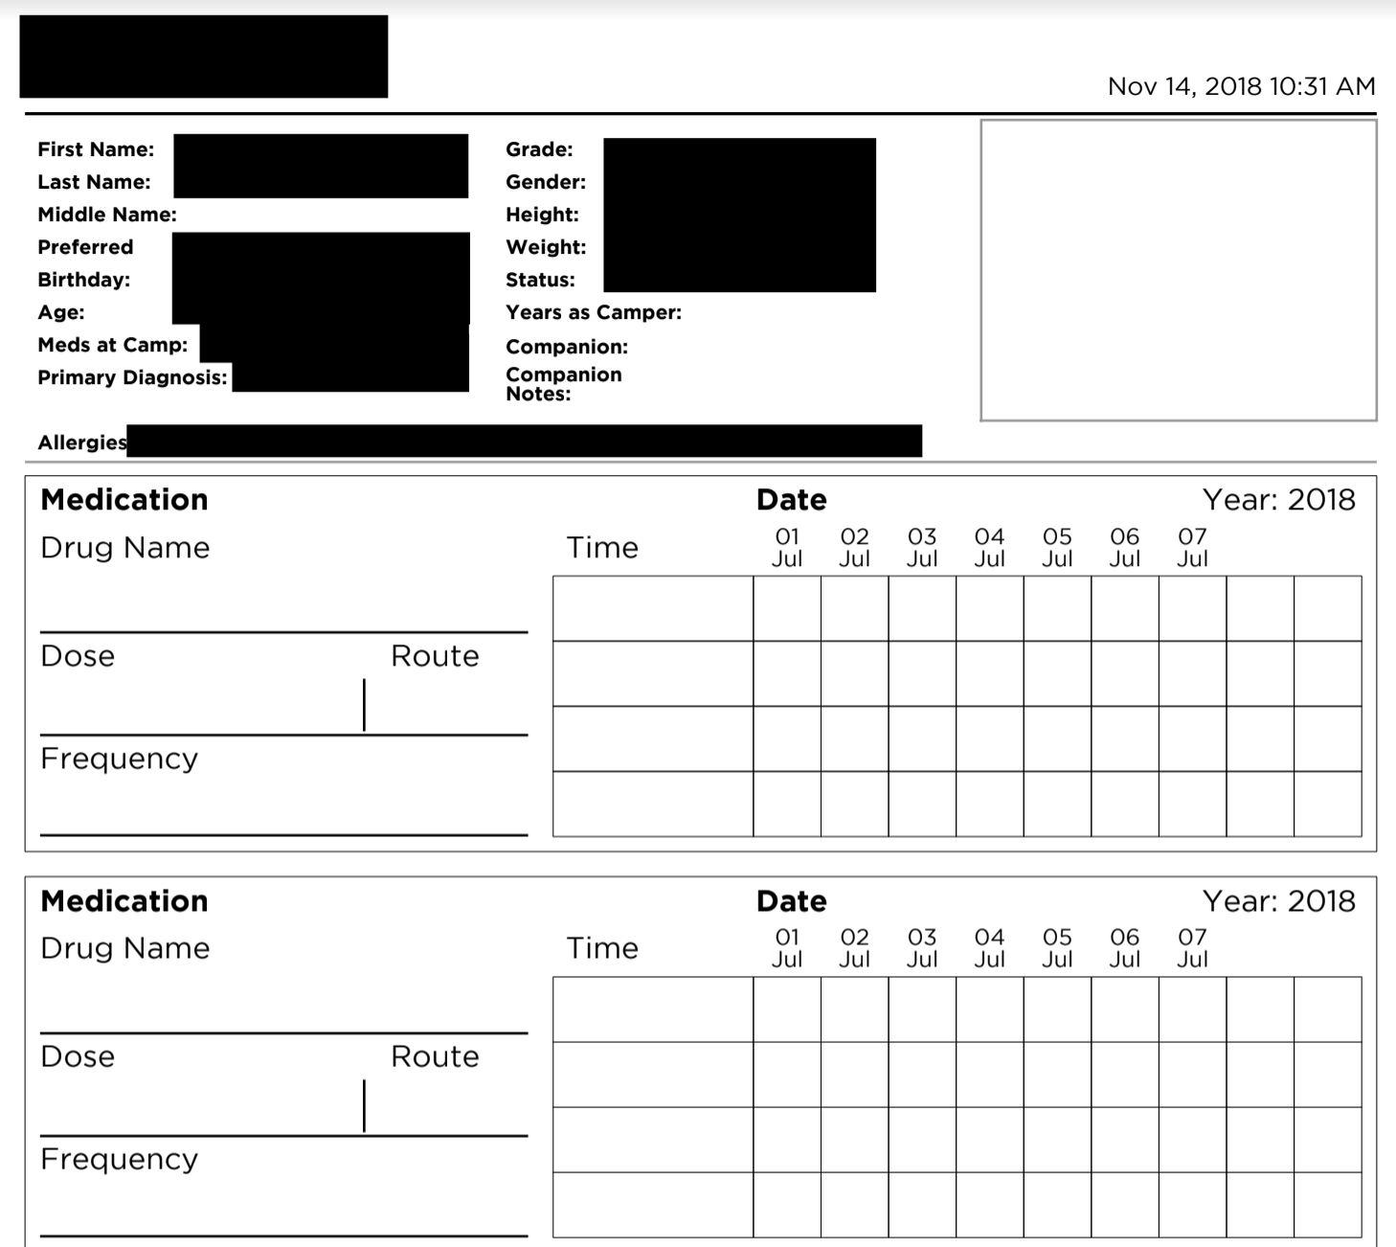
The problem
Camp registration requires filling of many paperworks
Tracking of medication requires the printing of dataset from 3rd party application and require the use of manual checking the medication in-take
Usability is hard due to multiple procedure to generate report which is used for tracking purposes.

Slide 3
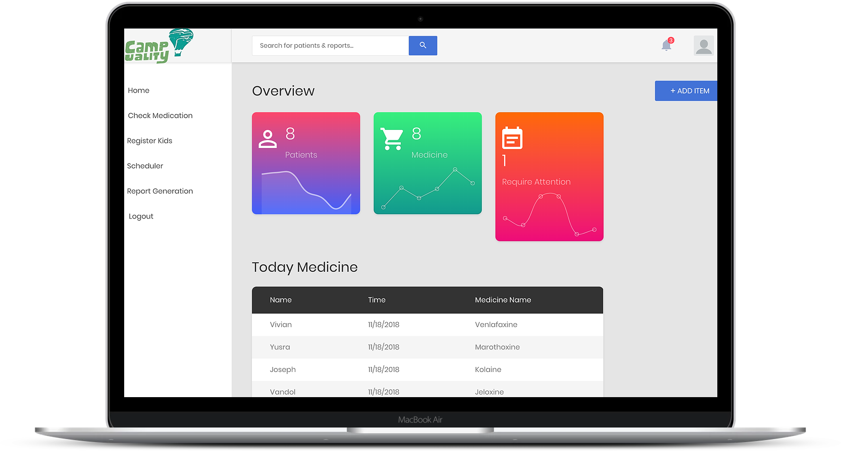
The Solution
An Web application that deals with creation of campers profile. Each camper profiles will have tracking ability of user medications that camper workers are able to track using the Application.

Slide 4
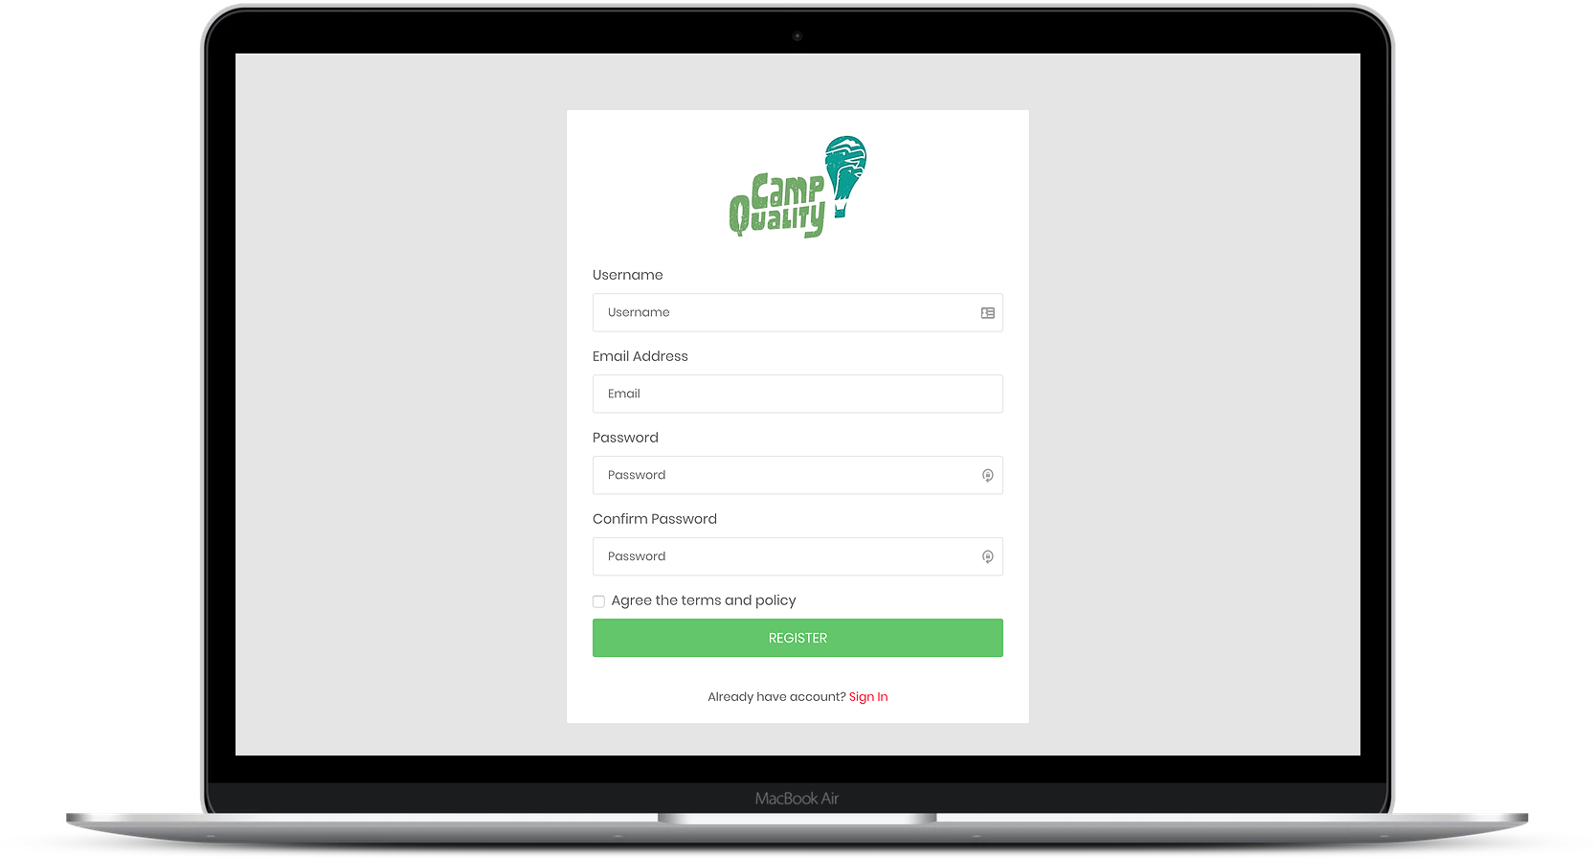
Registration of workers
Each workers requires the use of their own account to do management of each campers.
Each users are session managed via the Database to keep track of all their activities for Admin related purposes.

Slide 5
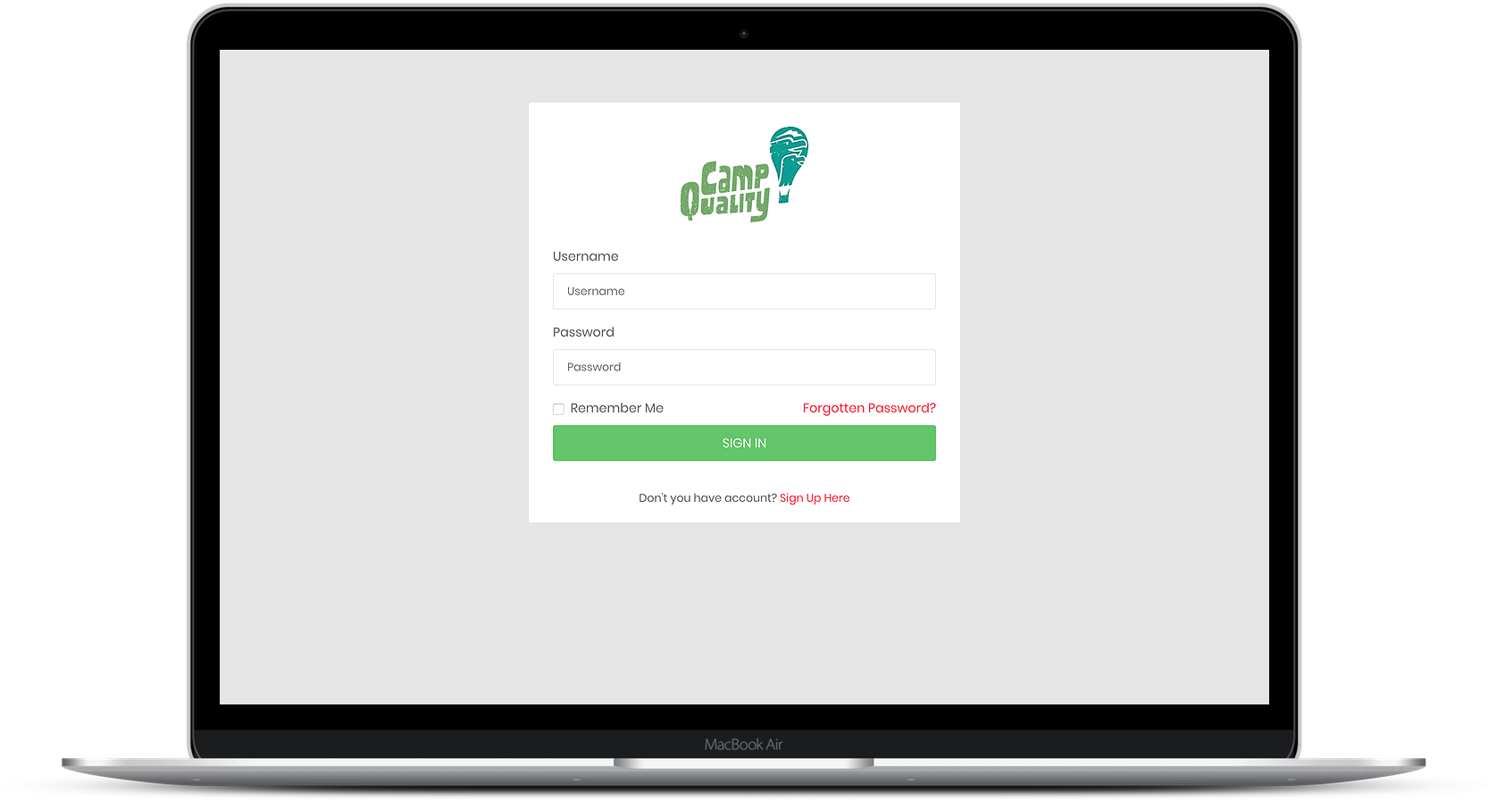
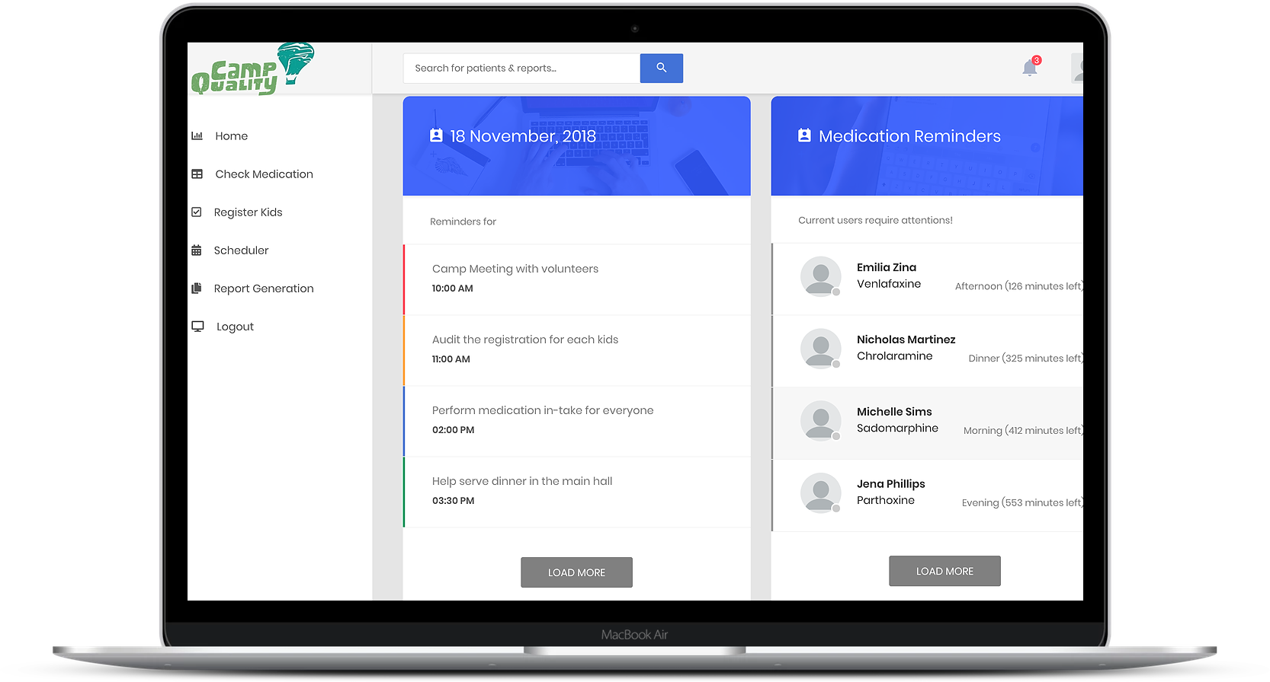
Application Console
login
The application console allows the user to view their daily task: - Overview/ general detail of patient requiring attention today. - Any reminders, or calendar invite their have including the list of medicine they must feed to the campers today.

Slide 6
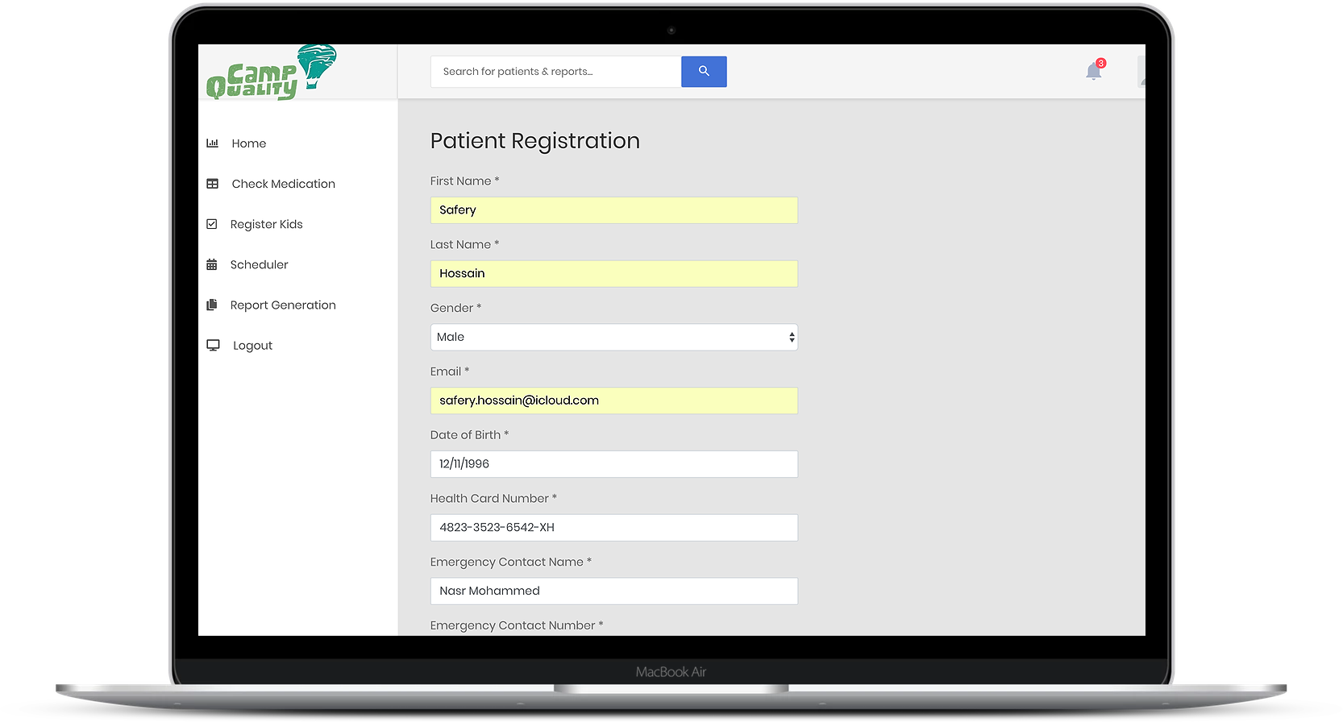
Register of campers
Easy to use GUI to register kids with respected detail
Filling of medication requirement
Uploading of detailed documents that was filled up prior to the registration by the parents.

Slide 7
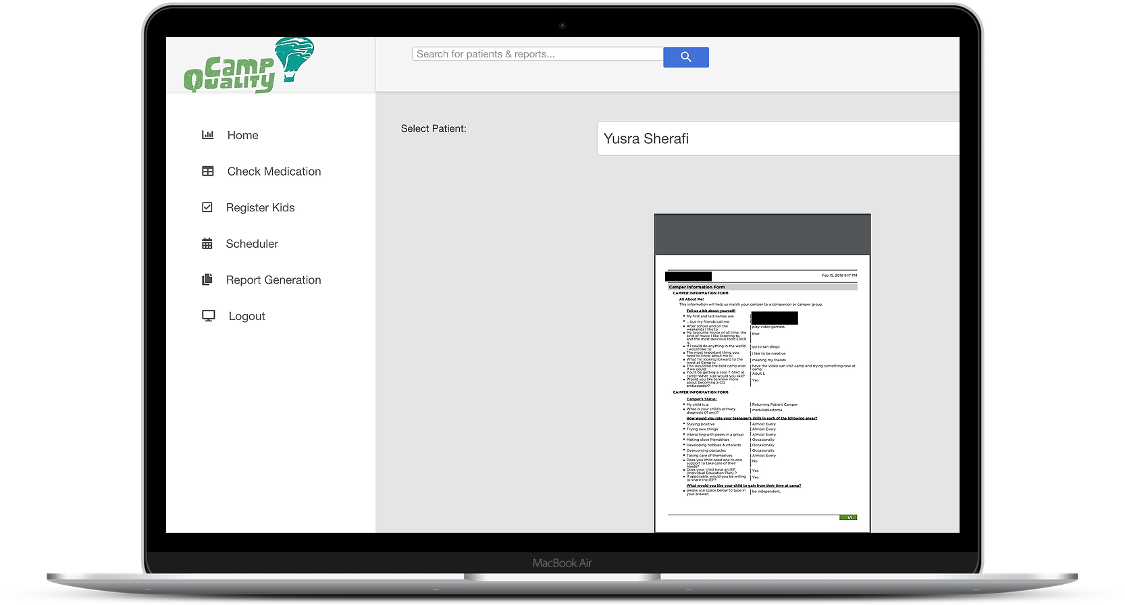
Generation of Campers Data
If required, it is easy to generate respected campers data. These data contains further details of medical history, emergency contacts or other information as given.
These generations are easy applicable for download or printing.

Slide 8
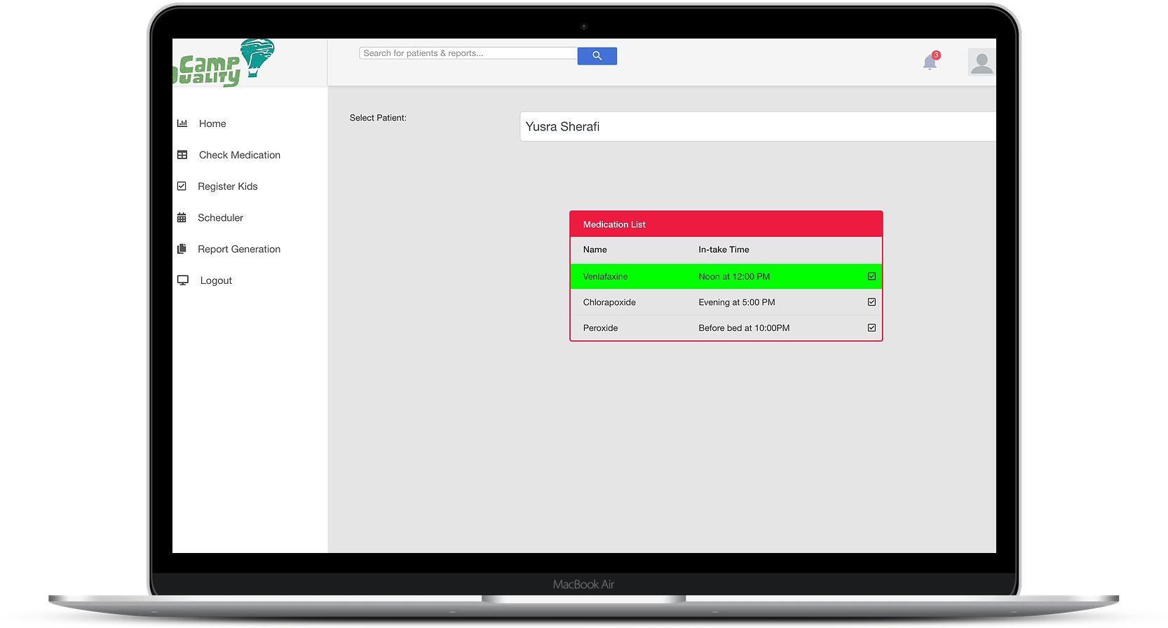
Checking medical in-take
Camp workers are able to check kids and their medication requirement
The medication requirement gets reset on the respected in-take time. Therefore, the workers are able to determine if the kids have taken their medication for the given day.

Slide 9
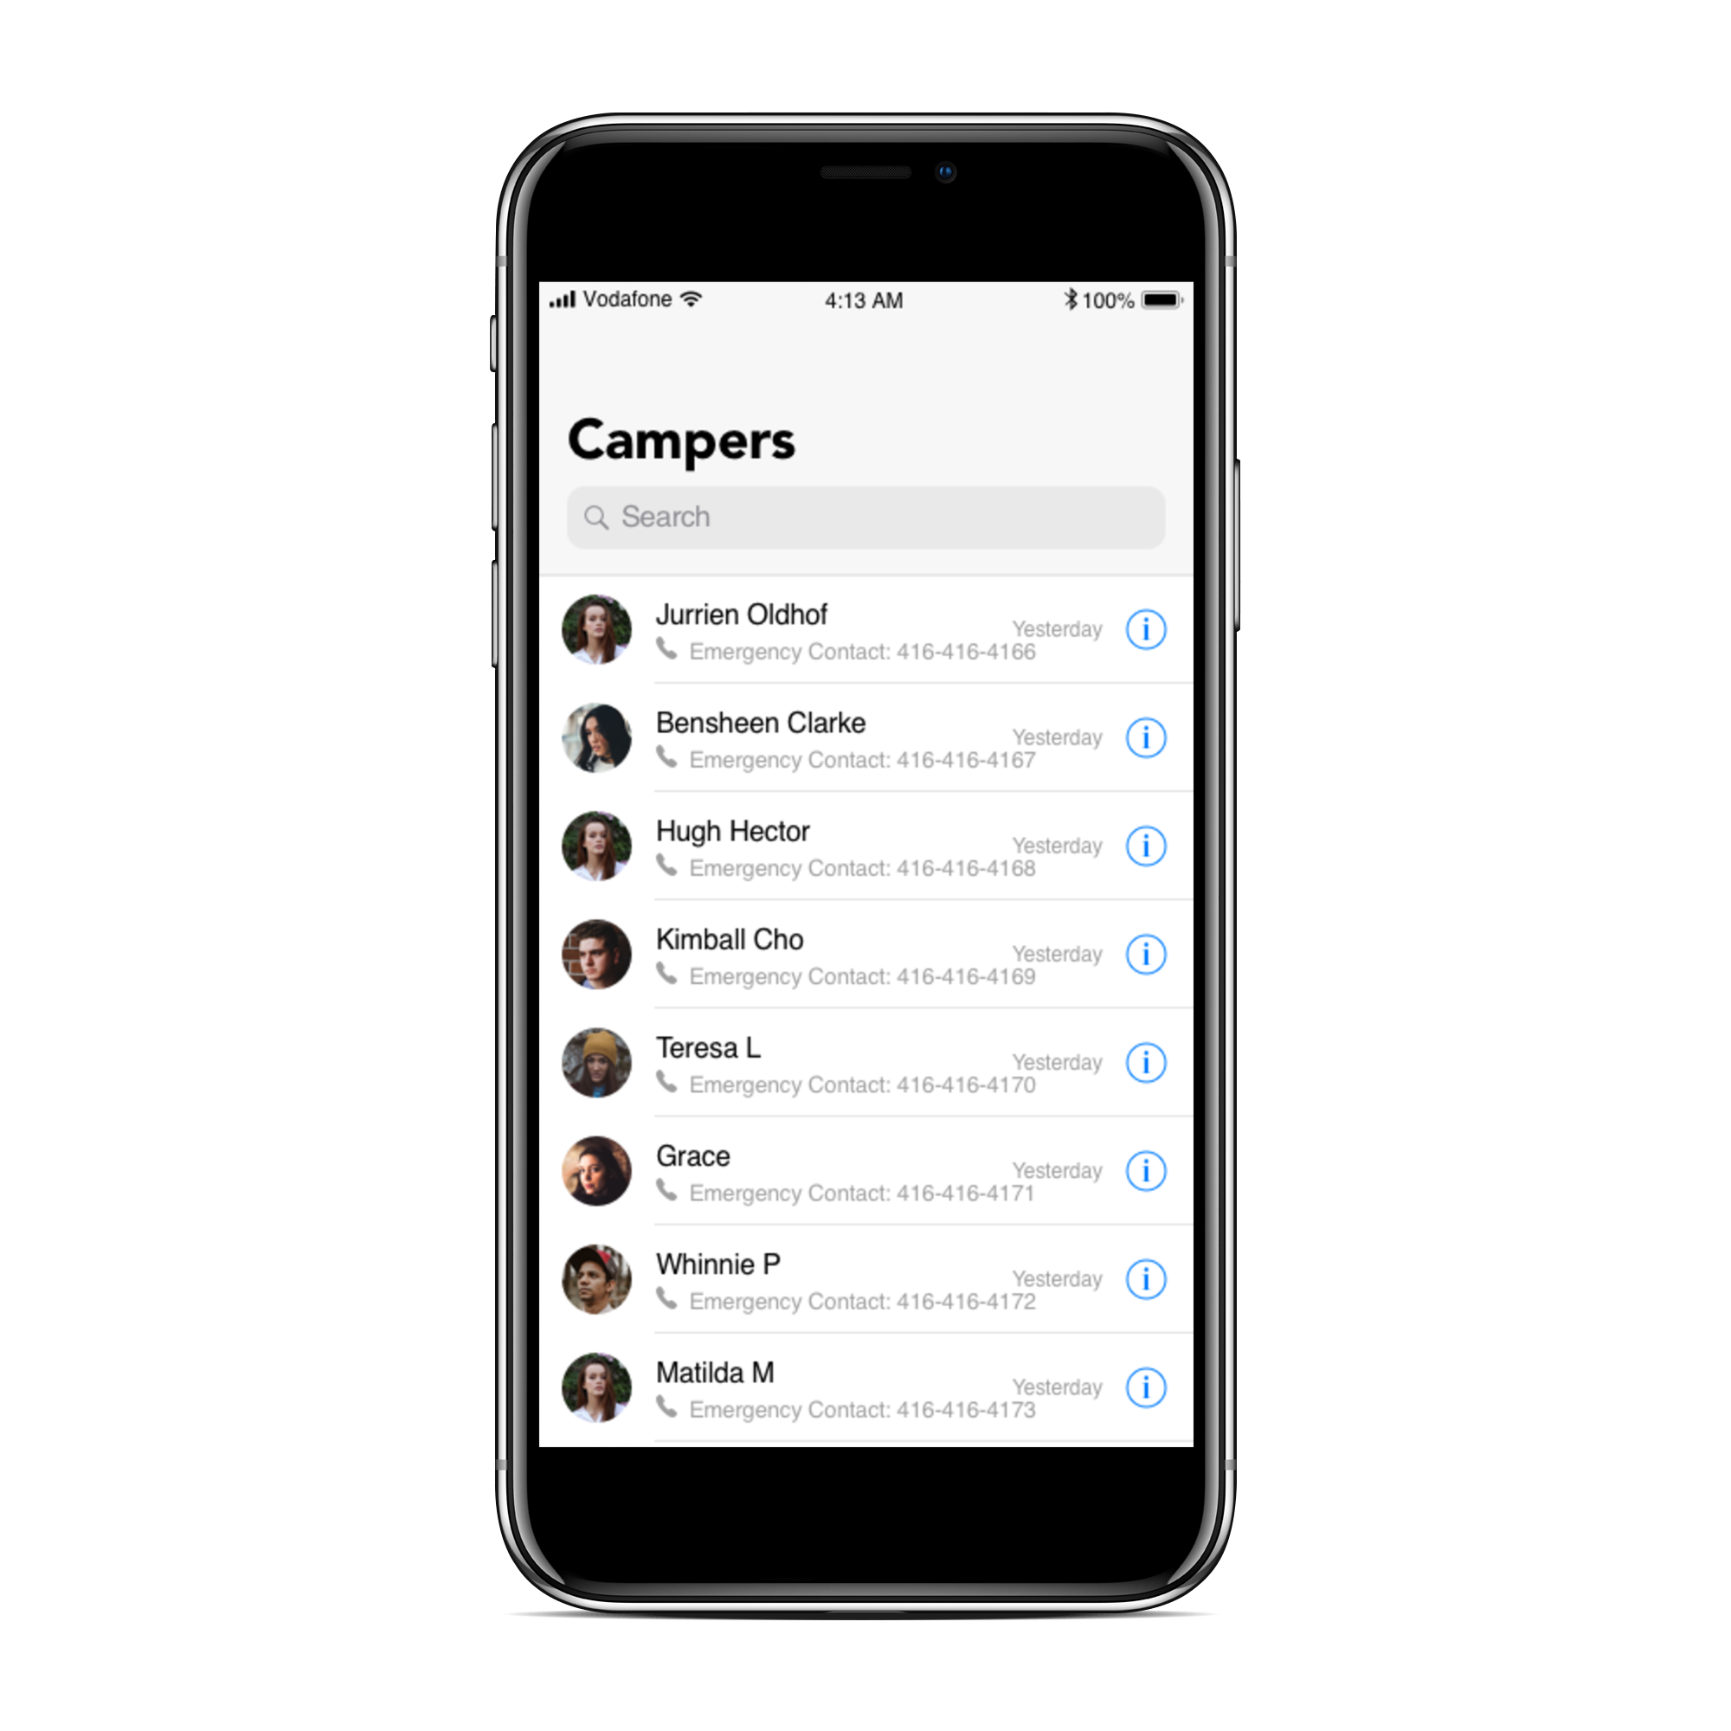
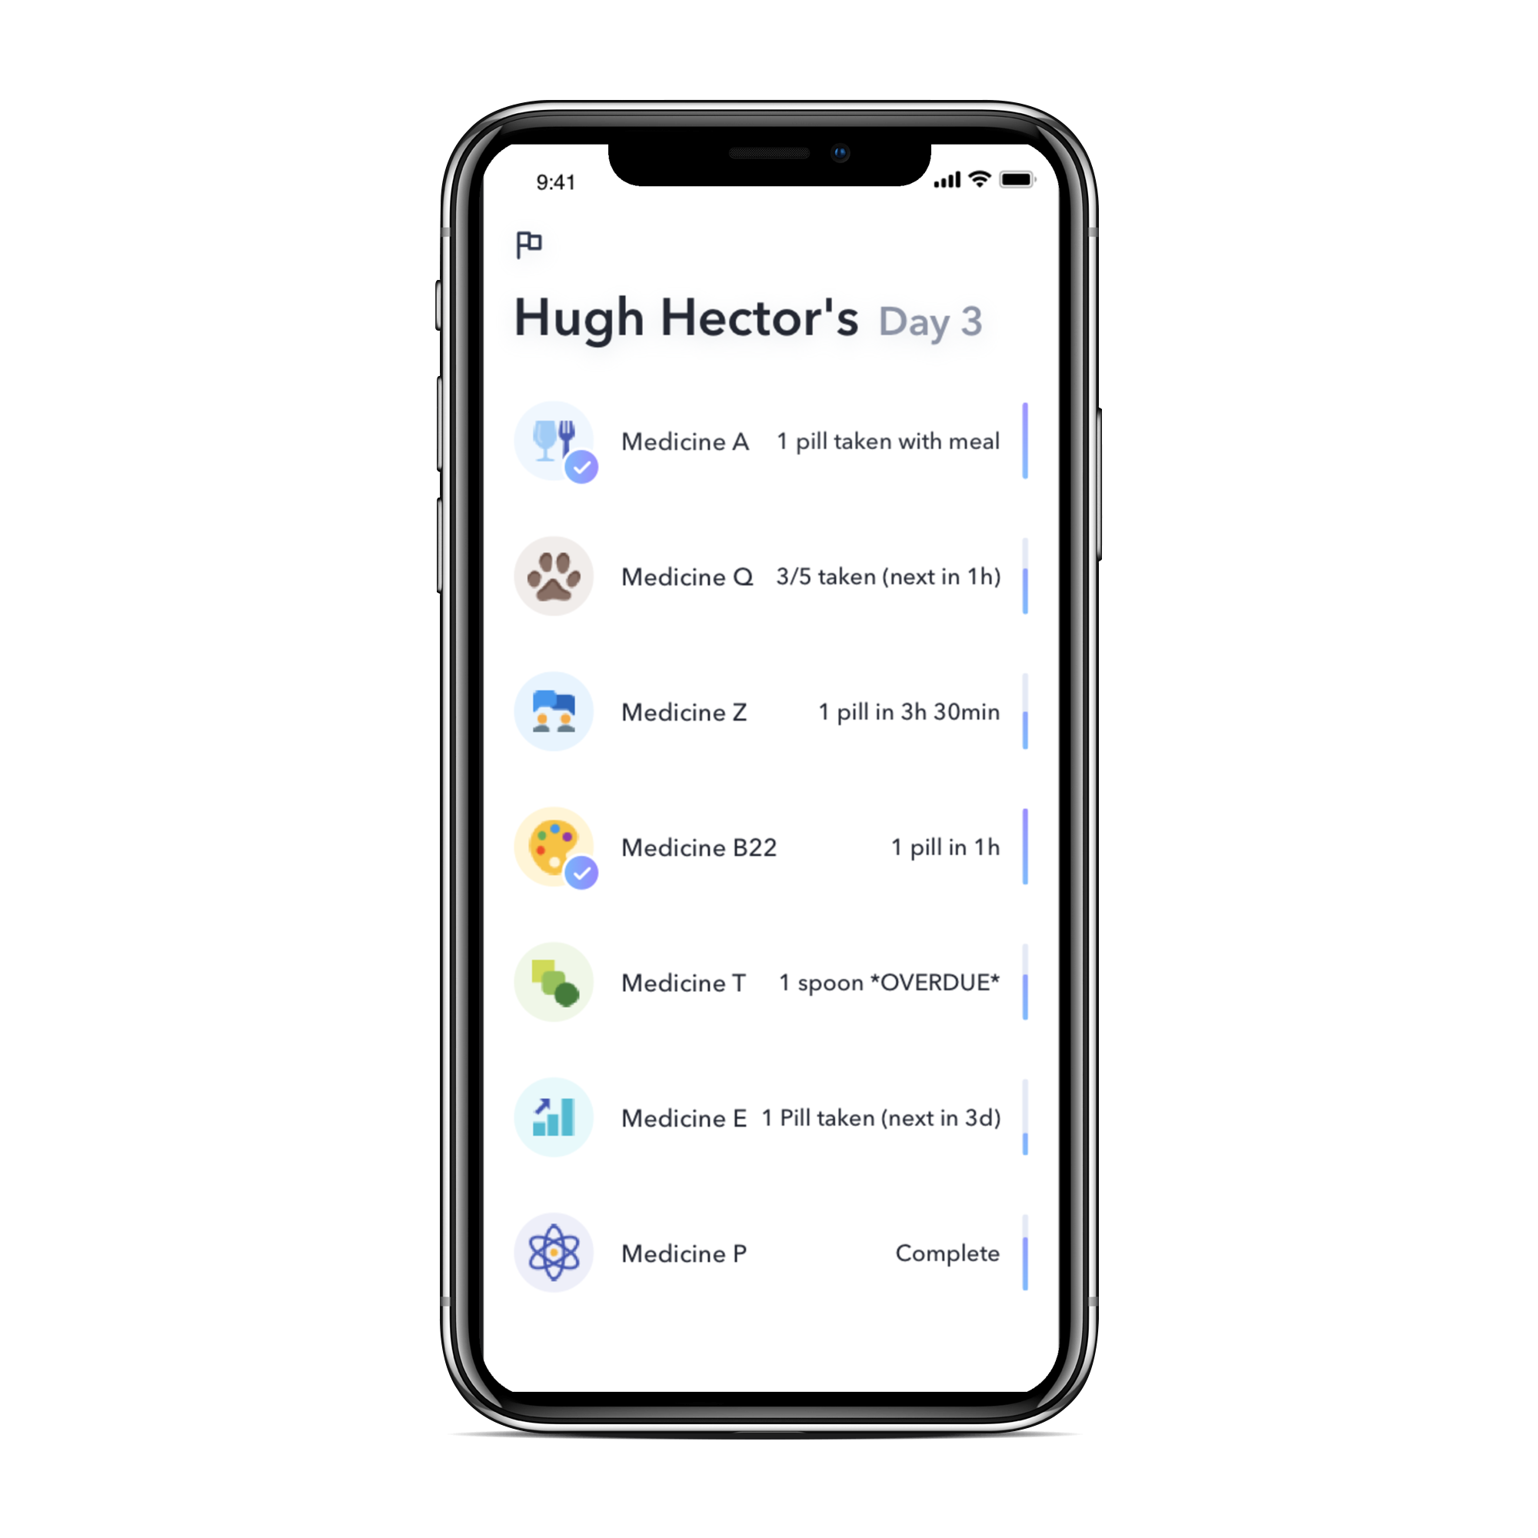
The mobile App (universal solution)

Slide 10
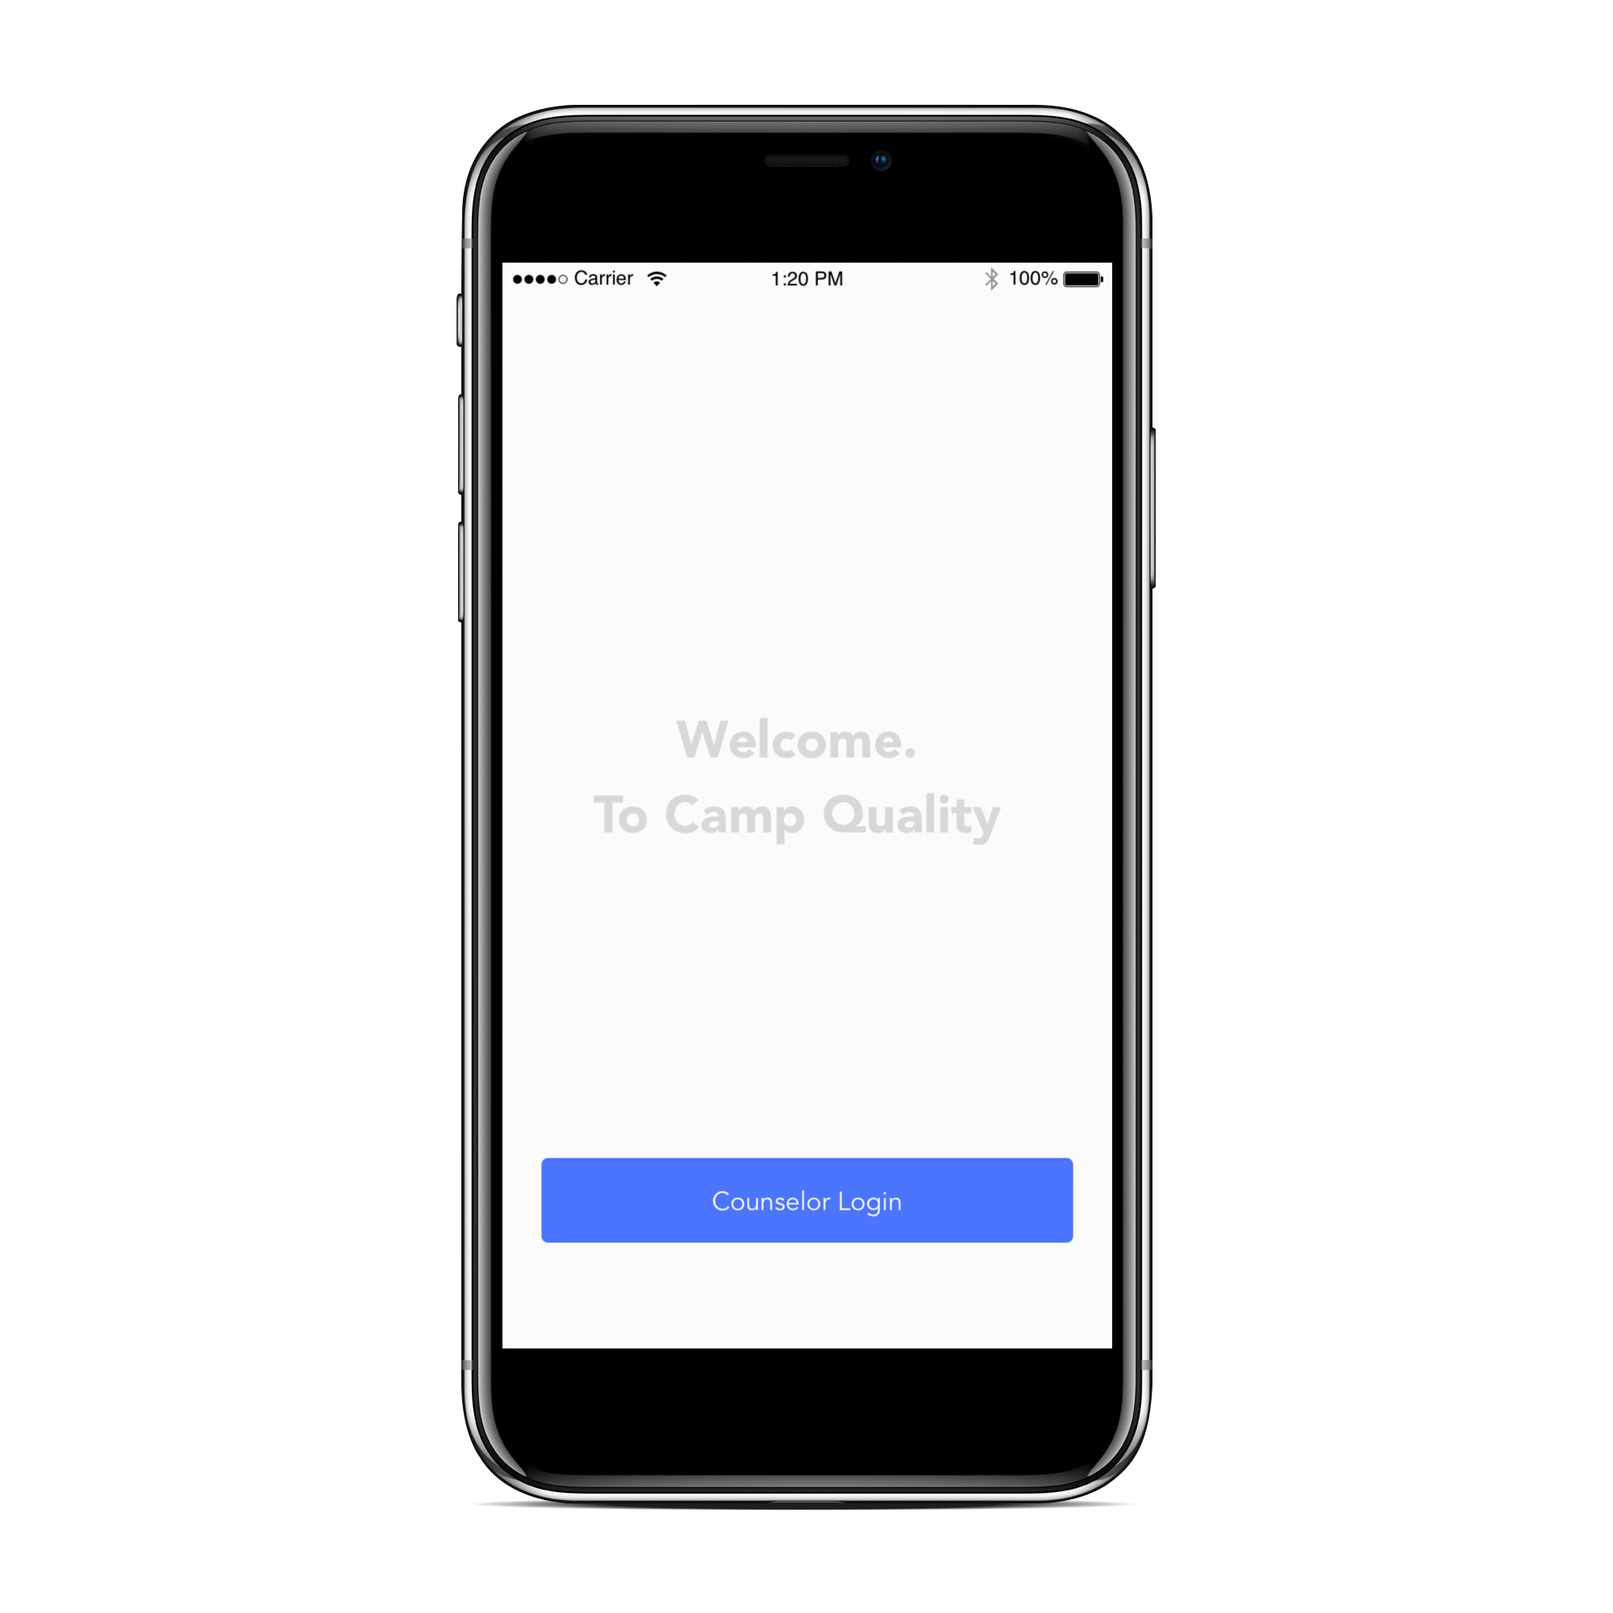
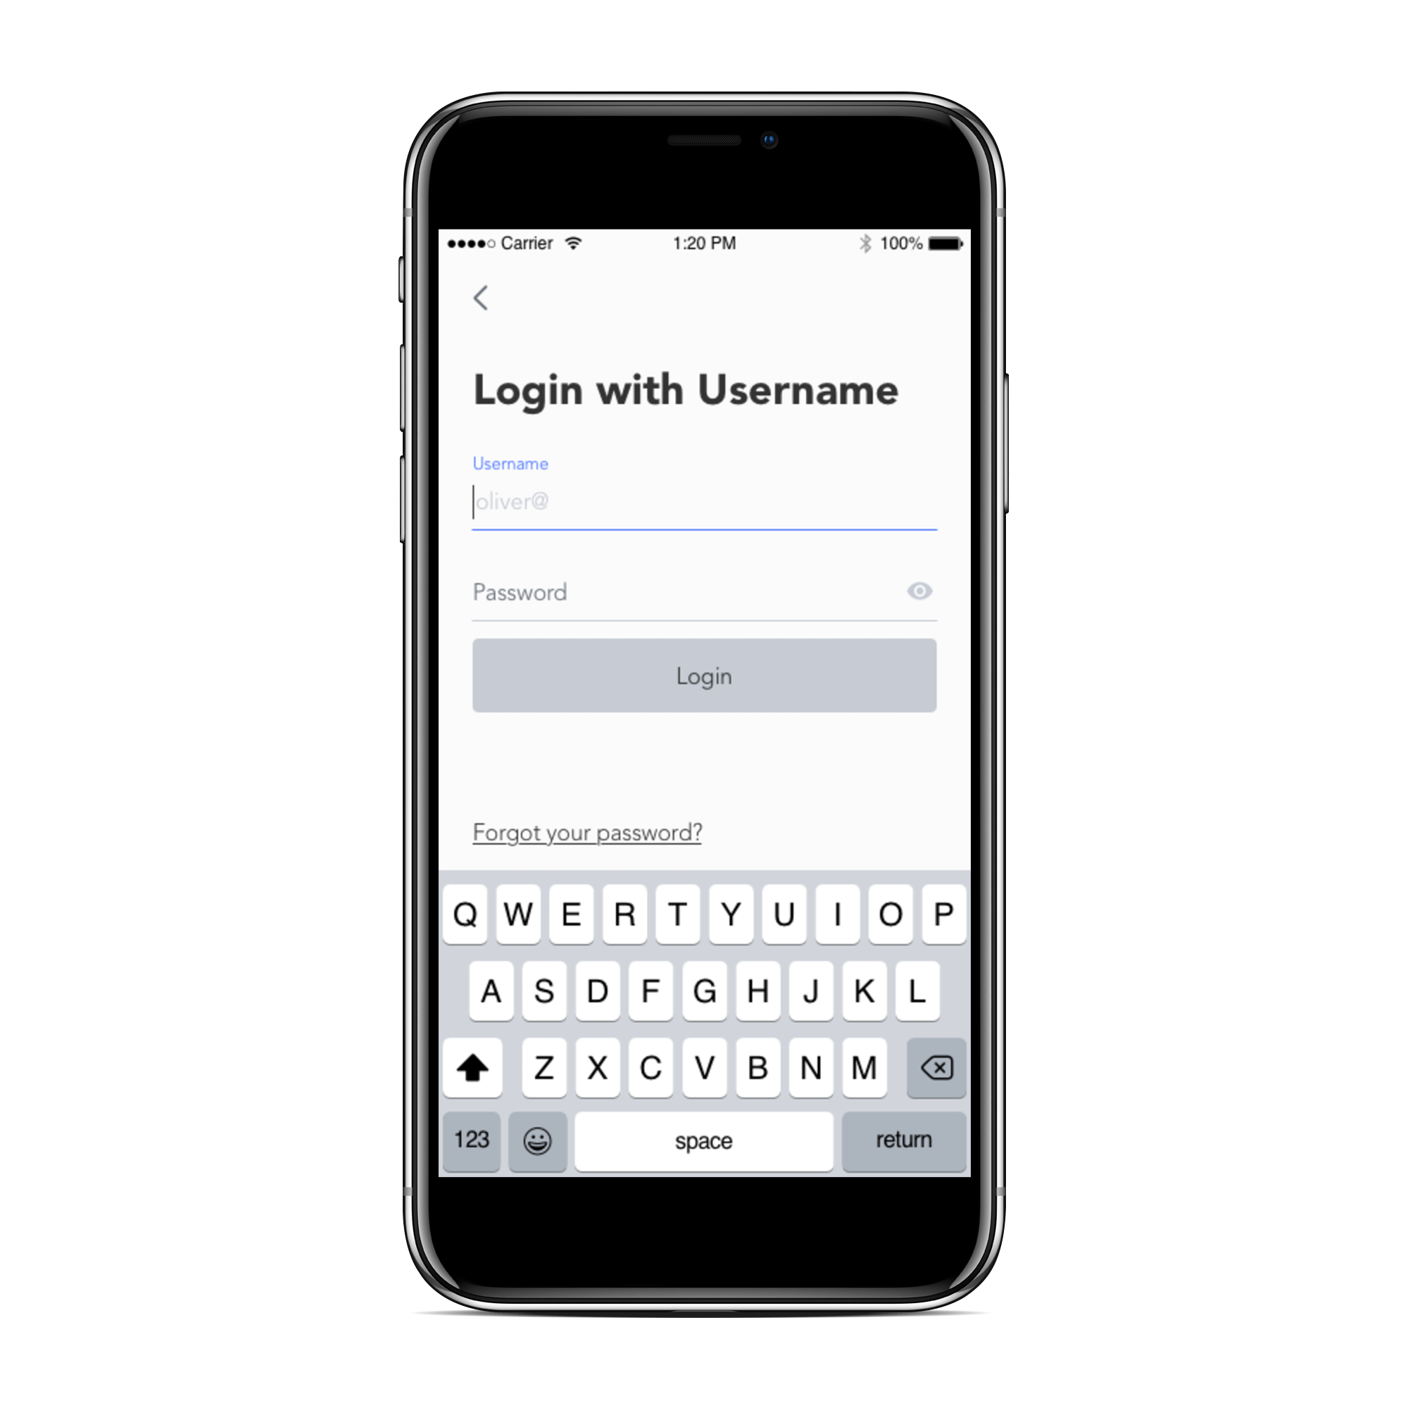
Landing page and Login

Slide 11
Camper Search
Allows the counselor to search through campers by name.
In case of possible emergencies the Emergency Contact number is made visible right away
To the left of each panel a ‘yesterday’ indicates the last time the persons page was viewed
Clicking on the “i”-icon will take the user to the medical information page for that camper

Slide 12
Medical Information Page
At the top of the page is the name of the camper, followed by the number of days spent at camp
The medical information page lists the medication name followed by information regarding the next dosage.
If dosage has a time requirement (i.e, take twice daily) then the countdown is noted as “in Xh (Ymin)”
When medication is overdue it is flagged *OVERDUE*

Slide 13
Why FECELITY
The creation of FECELITY was done via PHP and MySQL. This follows the same structure as the current camp quality website thus the only installation requirement is to drag and drop the files to the apache server and modify the SQL authentication file.
It is universal application that runs on the web browser and on the mobile phone. Workers do not need to carry around laptop or any equipment when tracking or even registering kids.

